Slide 1
OPENING RESTAURANT IN
PAULÍNIA, SÃO PAULO, BRAZIL
CourseraCapstoneProject
”

Slide 2
TABLE OF CONTENT
Business Problem
Methodology and Data
Exploring Paulínia Neighborhoods Exploring Paulínia Restaurants Results
Discussion
Conclusion

Slide 3
1. BUSINESS PROBLEM
According to FourSquare API, there are more than 200 restaurants in Paulínia and about 112,003 people. That is why opening a new restaurant there
can be an extremely challenging task. According to several surveys, up to 40% of such start-ups fail in the very first year. Let's suppose, an investor has enough time and money, as well as a passion to open the best
eating spot in Paulínia. What type of restaurant would it be? What would be the best location for it?
Target audience: investors, entrepreneurs, and chefs interested in opening a restaurant in Paulínia, who may require objective advice regarding what type of restaurant would be most successful and where exactly it should be opened.

Slide 4
2. METHODOLOGY AND DATA
Step 1. Using a table on https://cepbrasil.org/sao-paulo/paulinia, collect information about Paulínia neighborhoods.
Step 2. Use the Geopy and Folium libraries to get the coordinates of all locations and map geospatial data on a Paulínia map.
Step 3. Using Foursquare API, collect the top 100 restaurants and their categories for each location within a 500 meter radius.
Step 4. Group collected restaurants by location and by taking the mean of the frequency of occurrence of each type, preparing them for clustering.
Step 5. Cluster restaurants by k-means algorithm and analyze the top 10 most common restaurants in each cluster.
Step 6. Visualize clusters on the map, thus showing the
best locations for opening the chosen restaurant.

Slide 5
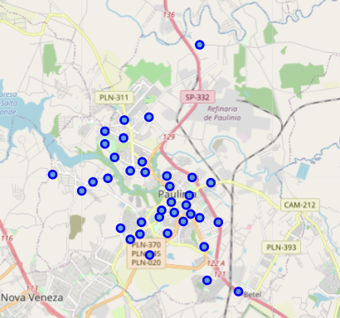
3. EXPLORING PAULÍNIA NEIGHBORHOODS
Using CEP Brasil we collected all of Paulínia's neighborhoods.
Using geospatial libraries we added geographical coordinates.
With some cleaning and wrangling, we obtained 38 locations in Paulínia.

Slide 6
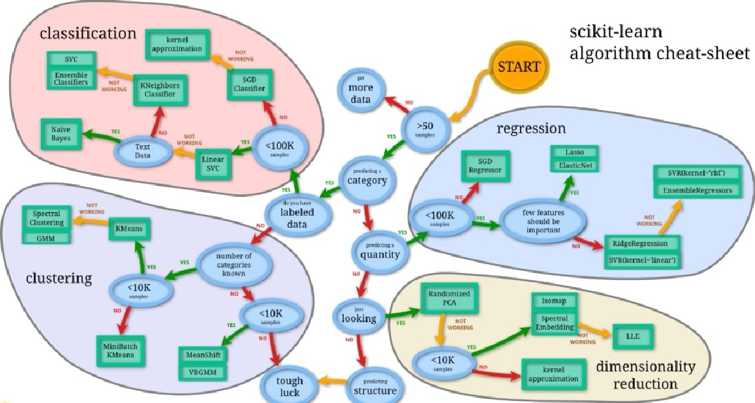

4. EXPLORING PAULÍNIA RESTAURANTS
We utilized the Foursquare API to get the top 100 restaurants
in each neighborhood.
Thus we obtained 172 restaurants of 32 individual types.
We applied one-hot encoding and grouped them by taking the mean of the frequency of occurrence of each type.
Then we clustered restaurants using the k-means algorithm
based on their types similarity. The k-means is an unsupervised machine learning algorithm for clustering unlabeled data

Slide 7
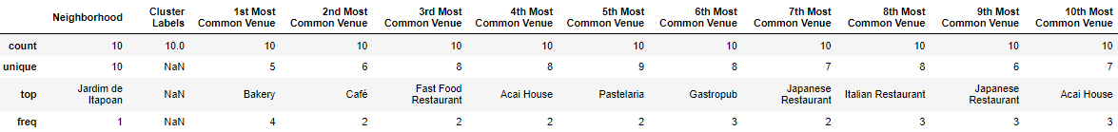

5. RESULTS
o Cluster #1
The most common restaurant: Bakery.
The 10t^{h} most common restaurant: Acai House.

Slide 8
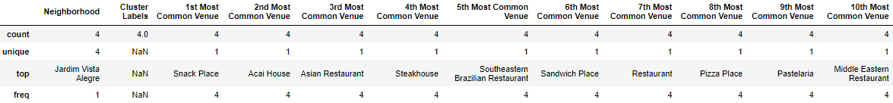
5. RESULTS
o Cluster #2
The most common restaurant: Snack Place.
The 10t^{h} most common restaurant: Middle Eastern Restaurant.

Slide 9
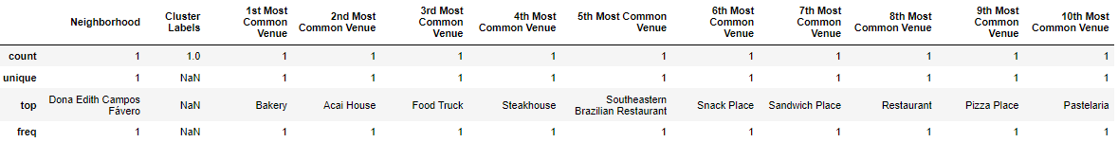
5. RESULTS
o Cluster #3
The most common restaurant: Bakery.
The 10t^{h} most common restaurant: Pastelaria.

Slide 10
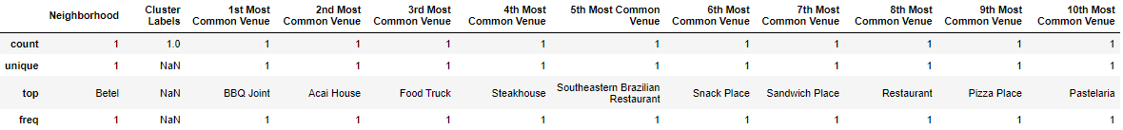
5. RESULTS
o Cluster #4
The most common restaurant: BBQ Joint.
The 10t^{h} most common restaurant: Pastelaria.

Slide 11
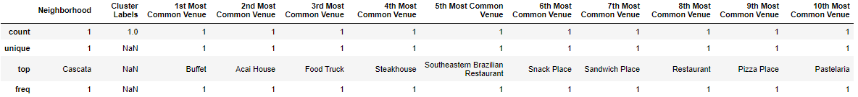
5. RESULTS
o Cluster #5
The most common restaurant: Buffet.
The 10t^{h} most common restaurant: Pastelaria.

Slide 12
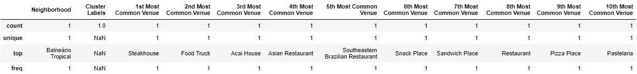
5. RESULTS
o Cluster #6
The most common restaurant: Steakhouse.
The 10t^{h} most common restaurant: Pastelaria.

Slide 13
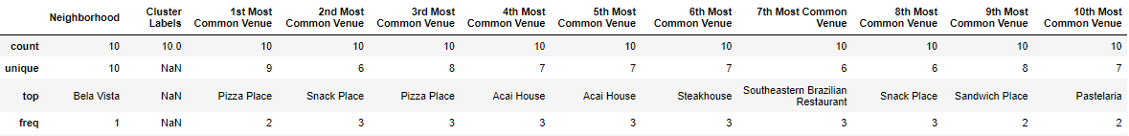
5. RESULTS
o Cluster #7
The most common restaurant: Pizza Place.
The 10t^{h} most common restaurant: Pastelaria.

Slide 14
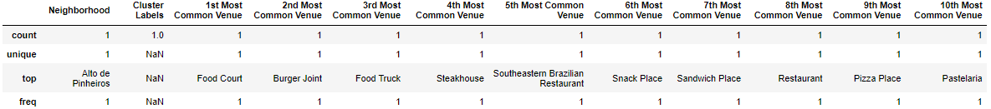
5. RESULTS
o Cluster #8
The most common restaurant: Food Court.
The 10t^{h} most common restaurant: Pastelaria.

Slide 15
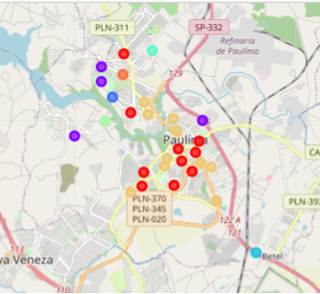
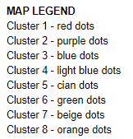
5. RESULTS
Visualizing Clusters

Slide 16
6. DISCUSSION
Analyzing the most popular restaurants in each cluster, the stakeholder should select the least popular types within the top 10 as a safe choice. In our recommendations we advise selecting from the 10th or 9th positions. This selection is a reasonable balance between being too popular and having no customers.
Recommendations, based on description of each cluster:
Cluster 1 Locations: Eastern European or Dumpling Restaurant Cluster 2 Locations: Empanada or Ethiopian Restaurant
Cluster 3 Locations: Eastern European or Ethiopian Restaurant Cluster 4 Locations: Eastern European or Dumpling Restaurant Cluster S Locations: Eastern European or Dumpling Restaurant
After the type of restaurant is chosen, it is time to select a suitable location, using the final map.

Slide 17
7. CONCLUSION
In this report we established a methodology to determine what the most promising type of restaurant is, and where it should be opened.
This type of analysis can be applied to any city of your choice that has available geospatial information.
This type of analysis can be applied to any type of venue (shopping, clubs, etc.) that is available in Foursquare database.

